Slide 1
Pathfinding Algorithm
A star algorithm, a better solution for many scenarios.
Chen Zhang

Slide 2
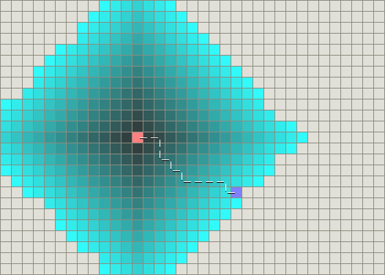
The Dijkstra’s Algorithm

Slide 3
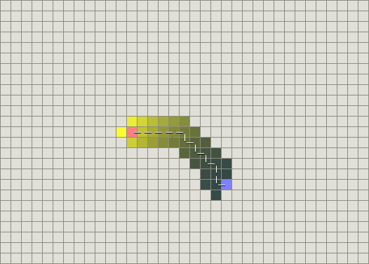
The Greedy Best-First-Search Algorithm

Slide 4
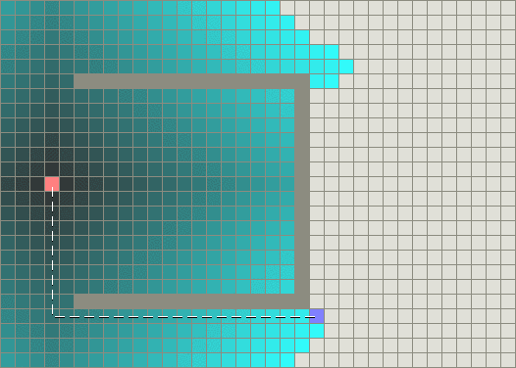
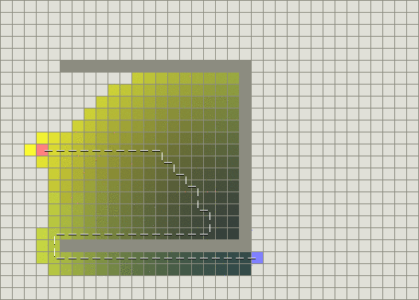
When encounter an obstcle

Slide 5
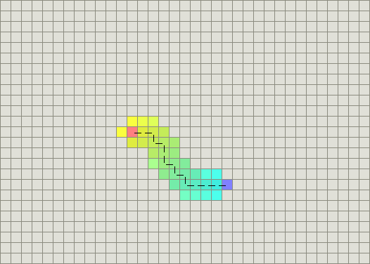
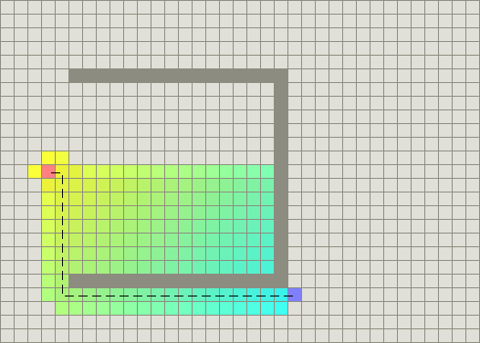
The A* Algorithm [ f(n) = g(n) + h(n) ]

Slide 6
The A* Algorithm Cont.
g(n) represents the exact cost of the path from the starting point to any vertex x
h(n) represents the heruistic estimated cost from vertex n to the goal
Each time the algorithm will examines the vertex n that has the lowest cost by doing
f(n) = g(n) + h(n)

Slide 7
The function o heuristic
if h(n) is zero and g(n) lead the cost function
if h(n) is always lower than the cost of moving from n to the goal
if h(n) is equal to the cost of moving from n to the goal
if h(n) is greater than the cost of moving from n to the goal
if g(n) lead the cost function

Slide 8
The Complexity
Time complexity
it’s polynomial when the earch space is a tree
Space complexity
it will store all the visited node in memory

Slide 9
Variants of A*
Beam search
Iterative deepening
Weighted A*
Bandwidth search
Bidirectional search
Dynamic A* and Lifelong Planning A*
Jump Point Search
Theta*

Slide 10
Summary
one source and one destination
use A*
one source, all destination
BFS
Dijkstra
Bellman Ford
Between every paire of nodes
Floyd Warshall
Johnson’s Algorithm

Slide 11
Thanks ~!

